Slide 1


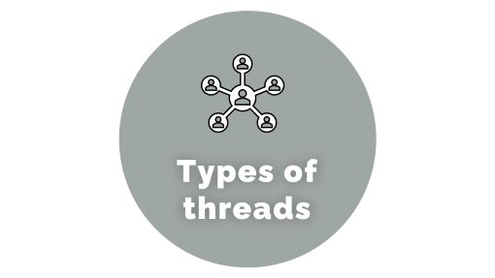
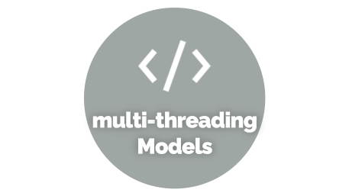
THREADS IN OS

Slide 2

INTRODUCTION

Slide 3
What is thread
A thread is a flow of execution through the process code, with its own program counter, system registers and stack. A thread is also called a light weight process. Threads provide a way to improve application performance through parallelism.
Each thread belongs to exactly one process and no thread can exist outside a process.

Slide 4
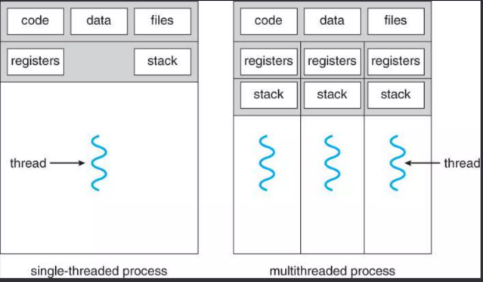
Single threads Process and Multi_threaded Process

Slide 5
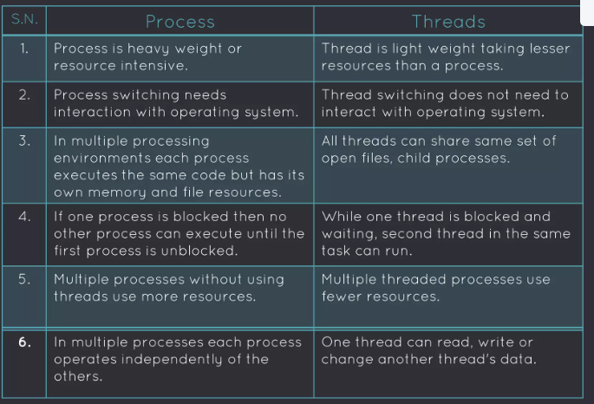
Difference between Process and Threads:

Slide 6
Advantages of Threads
• Thread minimizes context switching time.
• Use of threads provides concurrency within a process.
• Efficient communication.
• Economy- It is more economical to create and context switch threads.
• Utilization of multiprocessor architectures to a greater scale and efficiency.

Slide 7
Disadvantages of Threads
• Blocking of parent threads will stop all child thread.
• Security.

Slide 8

Types of threads

Slide 9
Types of thread
Threads are implemented in following two ways :
• User Level Threads (ULT)
• Kernel Level Threads (KLT)

Slide 10
User Level Threads (ULT):
User level thread implement in user level libraries, so thread switching does not need to call operating system and to cause interrupt to the kernel.
In fact, the kernel knows nothing about user level threads and manages them as if they were single-threaded process.

Slide 11
Advantage of ULT:
• User level threads does not require modification to operating system.
• Easy to represent and manage.
• User level thread can run on any operating system.
• User lexel threads are fast and efficient.

Slide 12
Disadvantage of ULT:
• There is a lack of coordination between threads and operating system kernel.
• ULT require non-blocking system call (i.e. Multithreaded kernel)

Slide 13
Karnel Level Threads (KLT):
In this method, the kernel knows about and manages the threads. No runtime system is needed in this case. Operating system kernel provides system call to create and manage threads.

Slide 14
Advantage of KLT:
• Kernel can simultaneously schedule multiple threads from the same process on multiple processes.
• If one thread in a process is blocked the kernel can schedule another thread of the same process.
• Kernel routines themselves can multithreaded.

Slide 15
Disadvantage of KLT:
• Kernel thread are generally slower to create and manage than the user threads.
• Kernel requires Thread Control Block (TCB) for each thread in the pool, hence complexity increases.

Slide 16

multi-threading Models

Slide 17
Multi-threading Models
Some operating system provides a combined user level thread and kernel level thread facility. Solaris is a good example of this combined approach.
Multi-Threading models are three types.
• Many-to-One Model
• One-to-One Model
• Many-to-Many Model

Slide 18
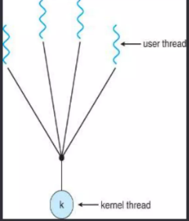
Many-to-One Model
Implementation of the many-to-one model (many user level thread to one kernel level thread) allow the application to create any number of threads that can execute concurrently. In this implementation, all threads activity is restricted to user space.
Additionally, only one thread can access the kernel at a time, so only one schedulable entity is known to the os.

Slide 19
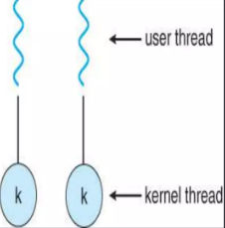
One-to-One Model
The one-to-one model (one user level thread to one kernel level thread) is among the earliest implementations of true multithreading. In this implementation, each ULT created by the application is known to the kernel,and all threads ca access the kernel at the same time.

Slide 20
One-to-One Model
The one-to-one model (one user level thread to one kernel level thread) is among the earliest implementations of true multithreading. In this implementation, each ULT created by the application is known to the kernel,and all threads ca access the kernel at the same time.

